Slide 1

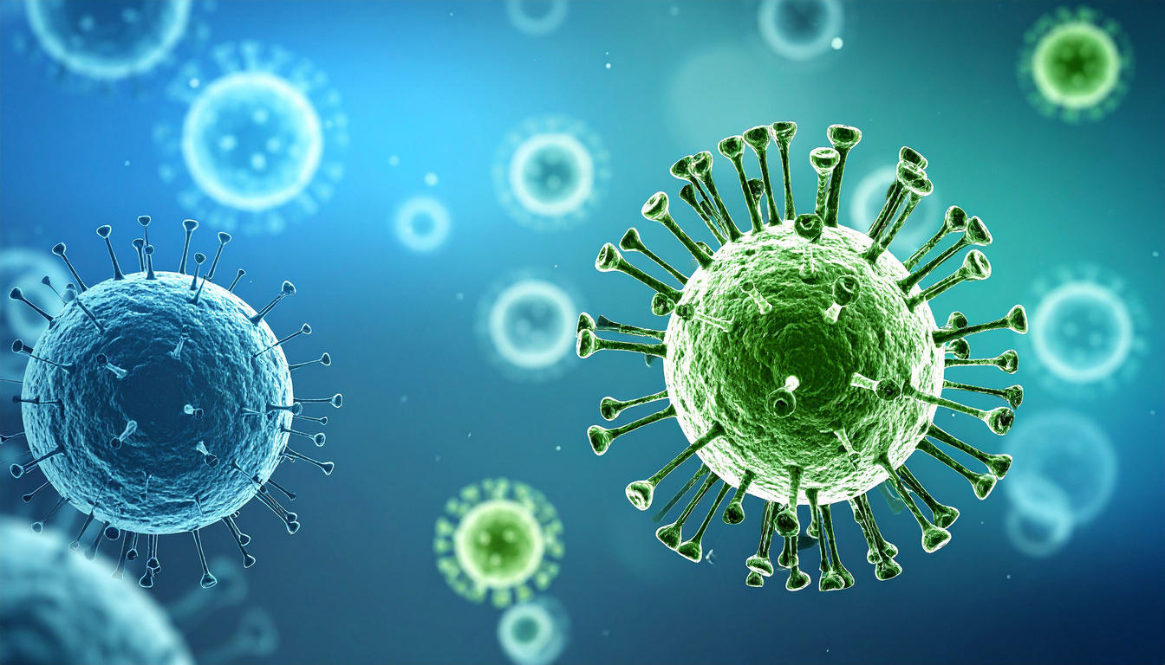
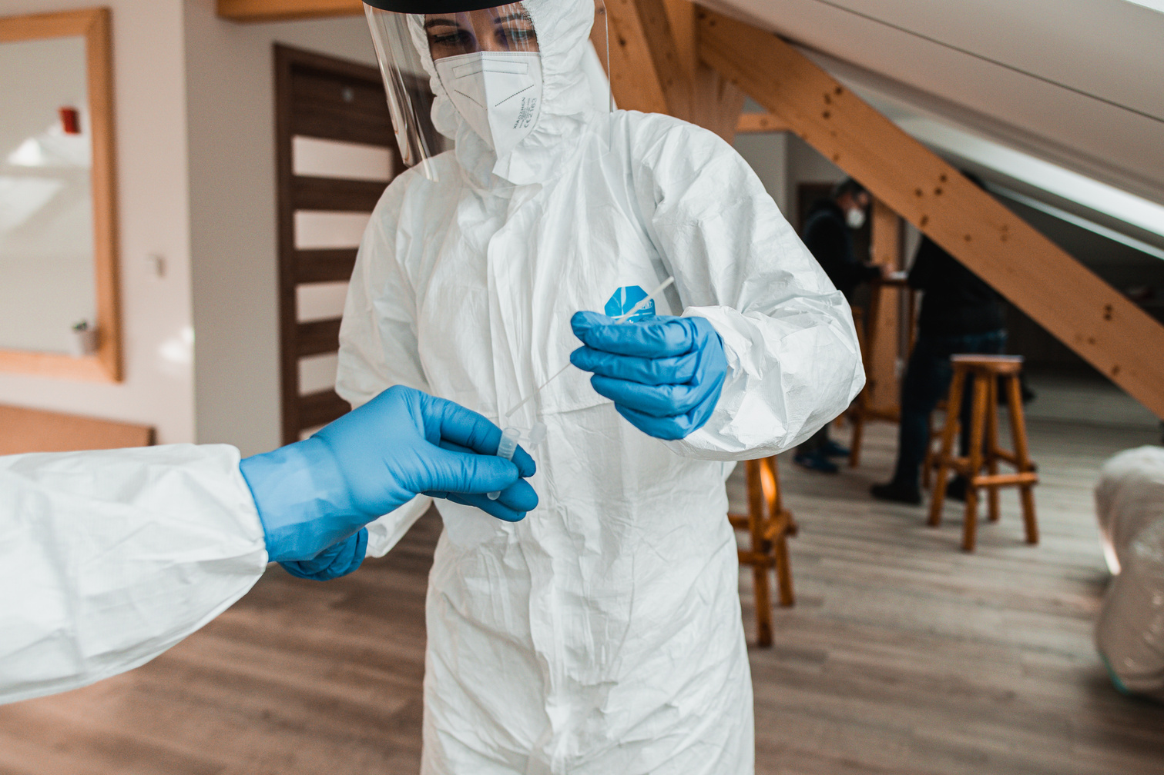
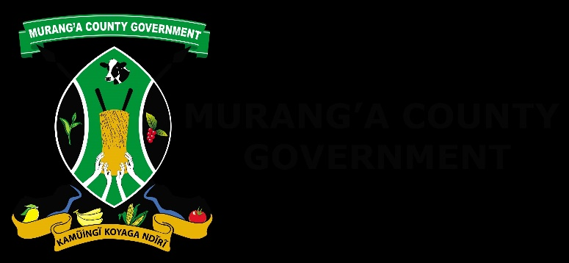
Leveraging Telemedicine to Strengthen Health System Resilience: The Murang’a County Experience.
Dr. Wendy Githu
Murang’a County Telemedicine Programme
Technological advancements in public health
Kenya Health Security Convention | 5th – 8th May 2026 | Mombasa - Kenya

Slide 2
Background
  Health systems in LMICs are under increasing strain.
  We are navigating: Severe workforce shortages, geographical barriers with rural- urban disparities and a rapidly rising burden of non-communicable diseases.
  In Murang’a, the doctor-patient ratio stands at 1:10,000 with 6 sub-county hospitals and 1 main referral hospital.
  Patients face: long travel distances, High costs and and fragmented follow-up.
  What if care could move closer to the patient, instead of the patient chasing care?
  TELEMEDICINE offered a solution to redesign our healthcare delivery in Murang’a.

Slide 3
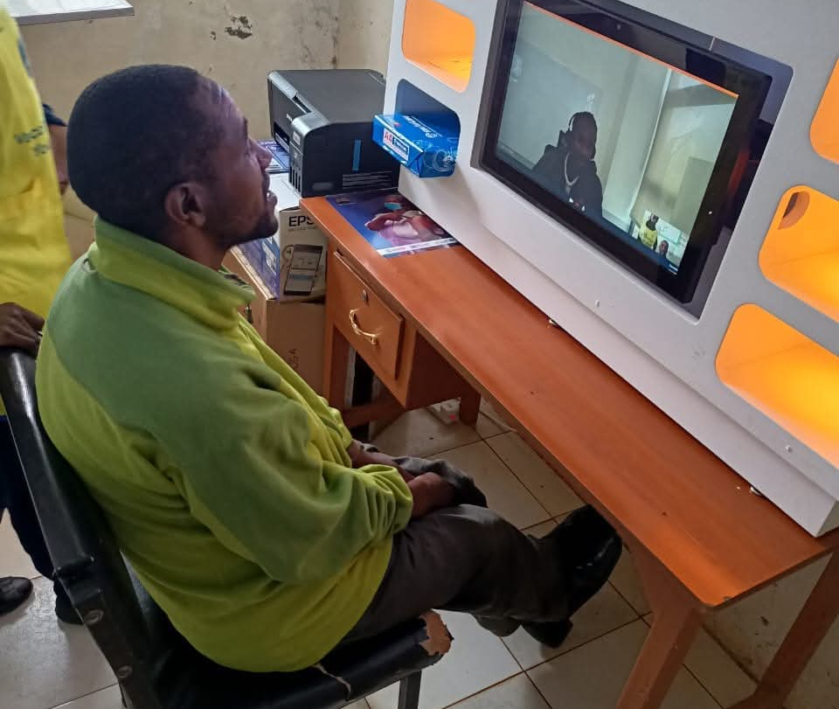
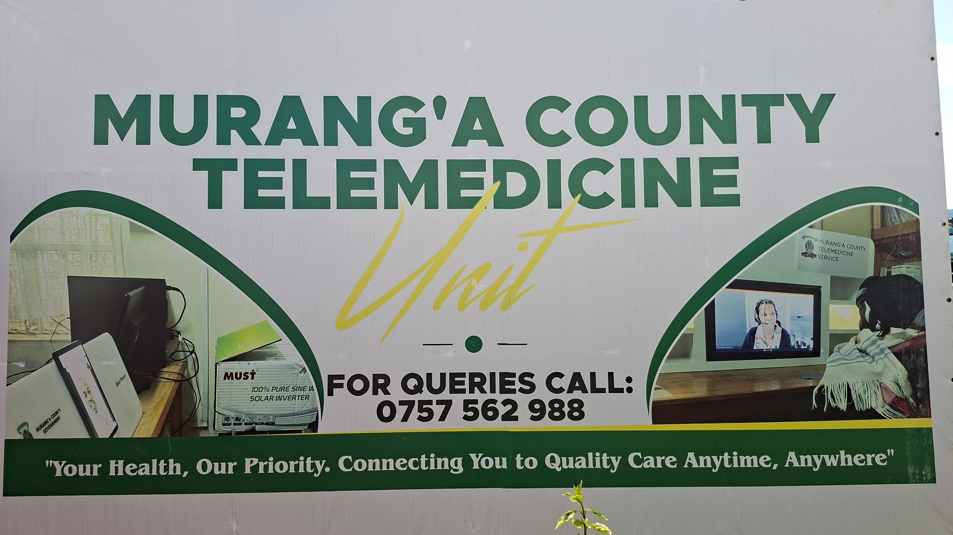
Objectives
  To demonstrate how a county-led telemedicine model can:
  Strengthen health systems.
  Improve access and continuity of care
  Enhance Pandemic preparedness

Slide 4
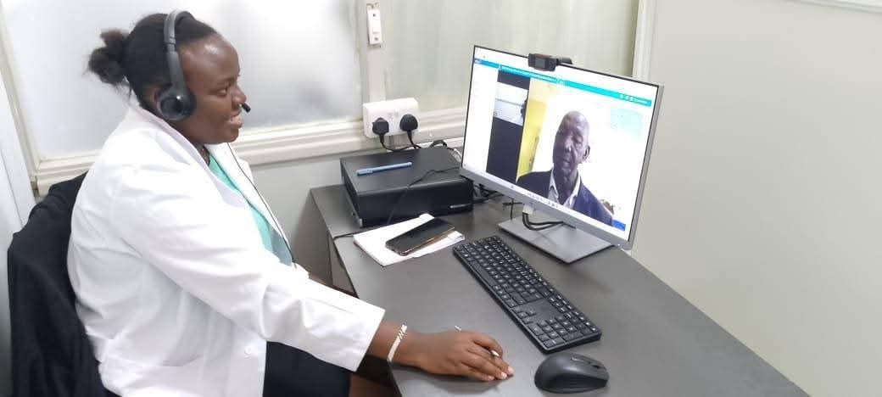
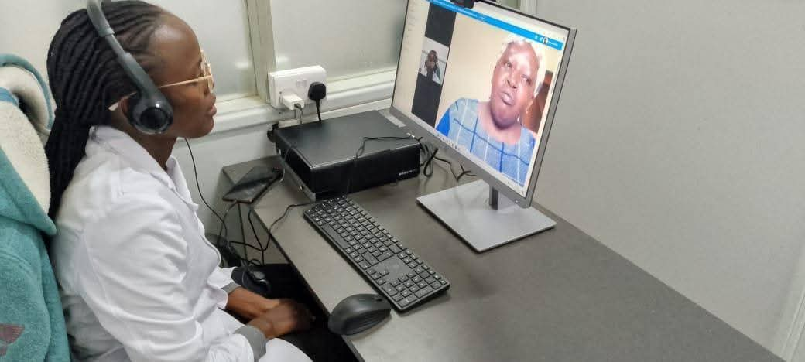
Methodology
  We adopted a hub-and-spoke model in Nov 2024.
  A central hub at Muriranjas Level 4 Hospital connected to 36 peripheral facilities.
  Patient onboarding was done at the community level through Public awareness campaigns, E-posters and Community Health Promoters.
  Patients recruited through clinical assessments and drug history review.
  Focused on 5 NCDs due to their demand of continuous, lifelong care.

Slide 5
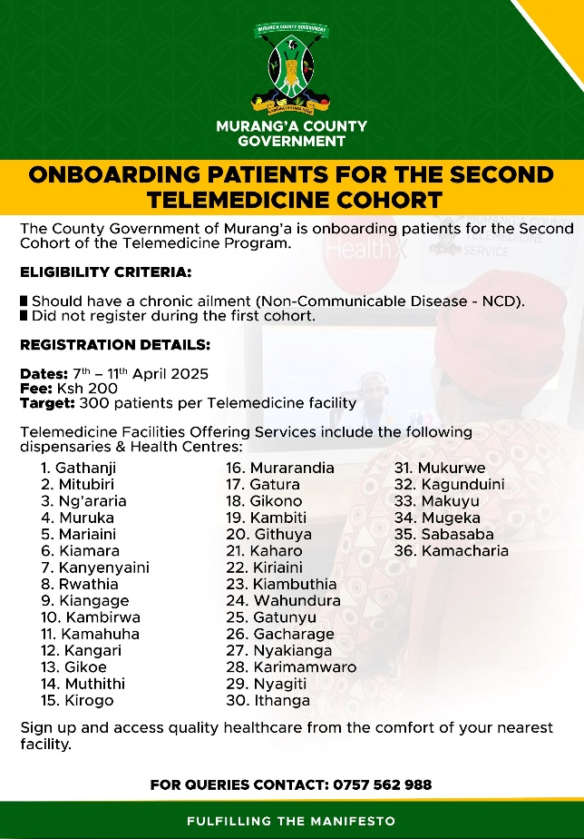
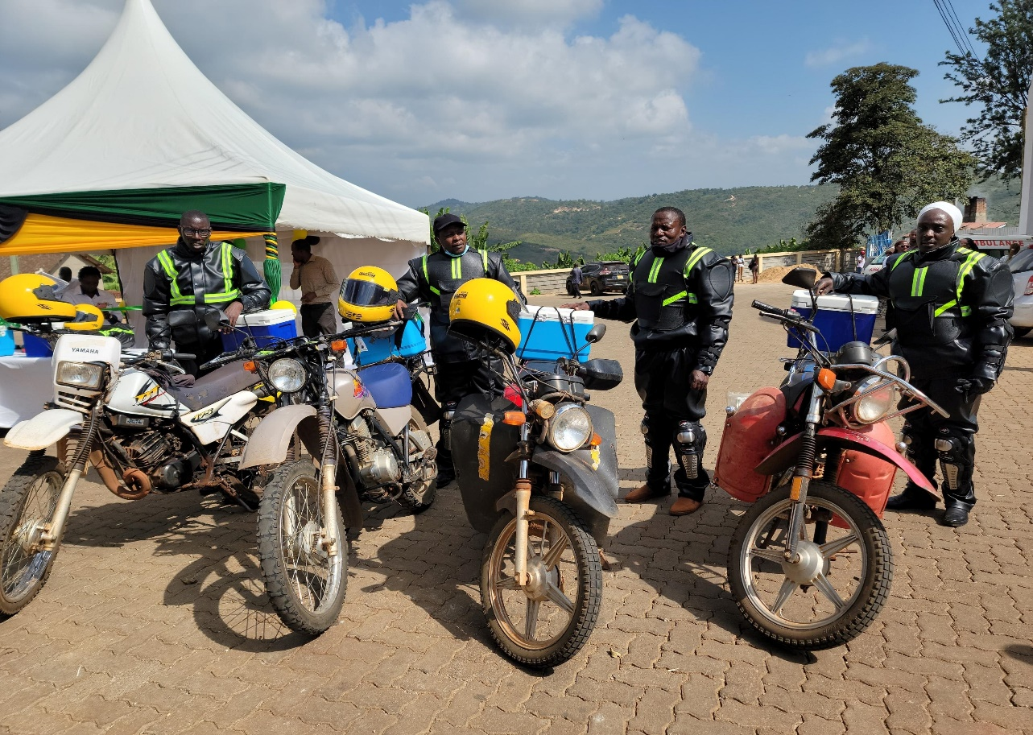
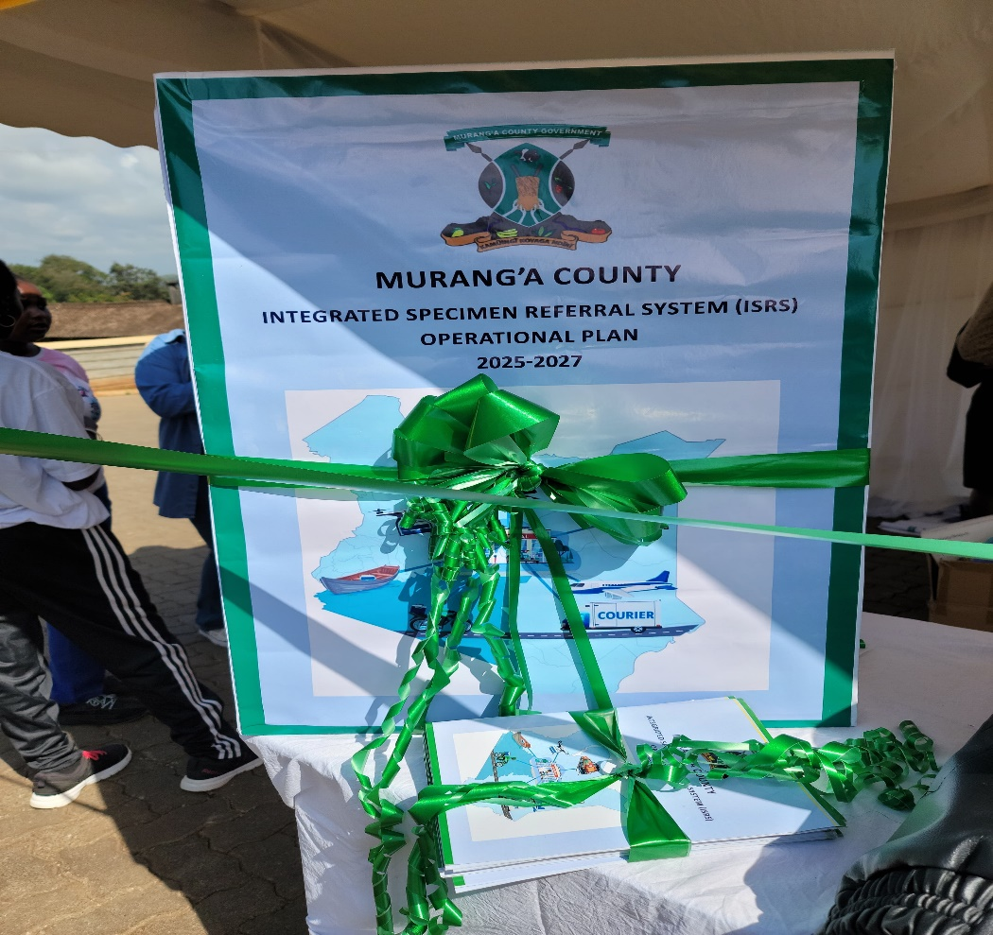
Methodology
  After registration patients were scheduled via call centers and linked to nearby virtual clinics.
  All healthcare facilities used one EHRS (AFYAKE) and were connected to stable power and internet supply.
  Virtual Consultations were initiated from the central hub and delivered in Kiswahili and the local dialect, Kikuyu.
  We also offered laboratory services for basic tests and have a lab referral system for advanced test across the County.10 Riders who collect samples ,results uploaded in the AfyaKe system.
  A central pharmacy store where we distribute drugs from to all facilities .Supplied by KEMSA and MEDS.

Slide 6
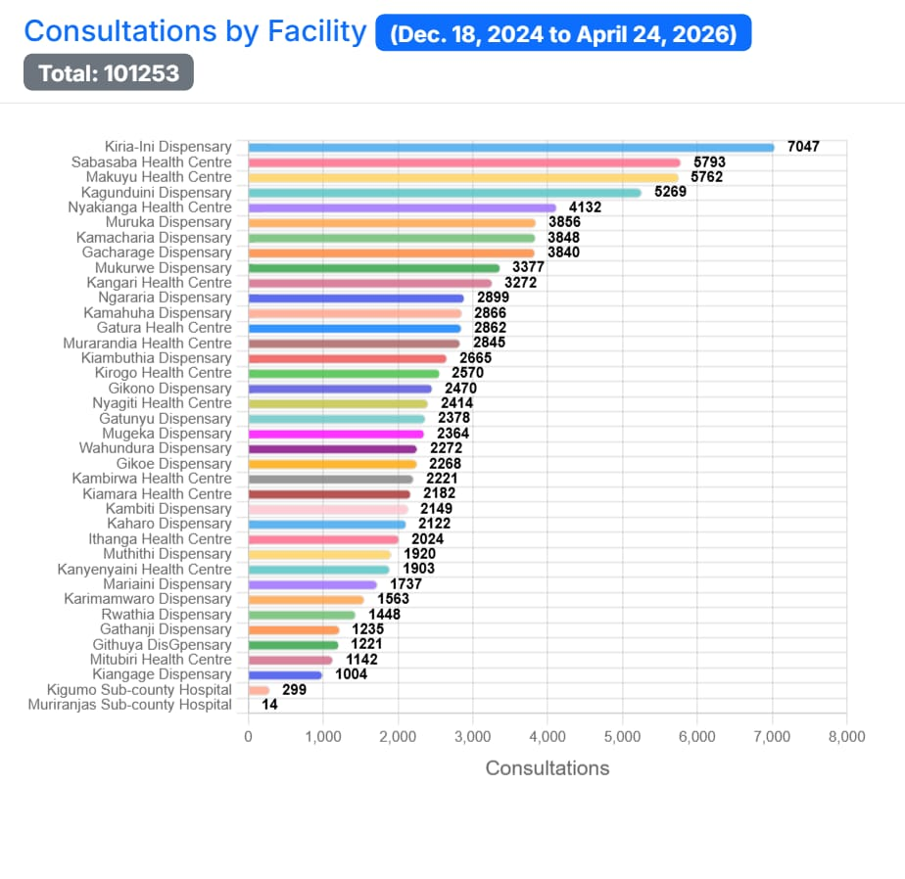
Results
  Programme Utilization - Over 21,500 patients registered, More than 100,000 consultations delivered , about 7,000 consultations every month.
  Health System Impact - 40% reduction in referrals, reduced congestion.

Slide 7
Results
  Patients outcomes
  40% increase in treatment adherence
  Over 80% follow-up attendance
  70–90% reduction in transport costs and time.

Slide 8
Discussion
  The Murang’a experience shows that telemedicine can:
  Decentralize care and overcome geographic barriers.
  Bridge workforce gaps
  Address the growing NCD burden.
  Public Health System Strengthening
  This digital platform enables :real-time health data access
  Data-driven decisions
  Preparedness for public health emergencies, including pandemics, by supporting remote triage, continuity of essential services and rapid information flow.

Slide 9
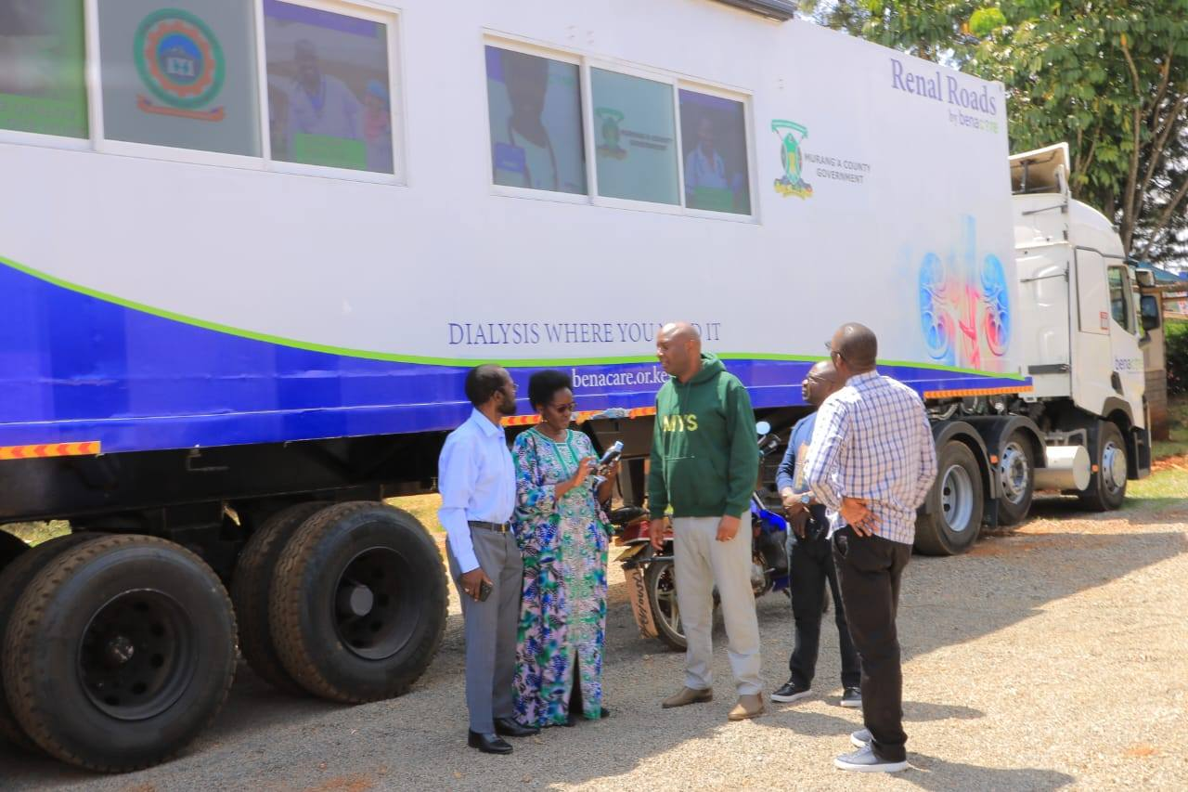
Conclusion
  The Murang’a Telemedicine Programme is a scalable, resilient model that is transforming how care is delivered.
  A demonstration that digital health can expand access, improve outcomes and strengthen our health systems.
  WHAT’S NEXT FOR MURANG’A COUNTY?
  Engage in Community Prevention Campaigns to create awareness on NCDs
  Open up Telemedicine for 24/7 operations, allow people to consult from home.
  Expand our Mobile Dialysis Programme for CKD patients.

Slide 10
Policy Impact and Implications
  To sustain and scale impact, we must:
  Invest in infrastructure.
  Integrate telemedicine into UHC frameworks
  Support community engagement
  Strengthen supply chain
  “If we are serious about universal health coverage, then innovation like this is not optional - it is essential.”

Slide 11

Thank you!
Scan to visit our website
#KeHSCon2026
@NPHIKenya
www.nphi.go.ke

